Slide 1

Bike Shop Project
https://github.com/manojmpg114/BikeShopProject
Geoff Cohen, Jason DeValerio, Manoj George, Karan Joshi

Slide 2
Progression
We went from working on the projects classes individually, to working on the classes together we were able to create our project without waiting to the last minute to get started.
Eclipse
Google docs
Edit code together and share updates in real time
Discord
Primary way we communicated, occasionally sharing files, getting our logs done.
Our online extension, most meetings to see how everyone was doing was done in class when class ended since we should have all attended regularly.
Github
Push and pull different committed work when bigger changes have been made and to also to keep group members files and directories up to date with the changes.

Slide 3
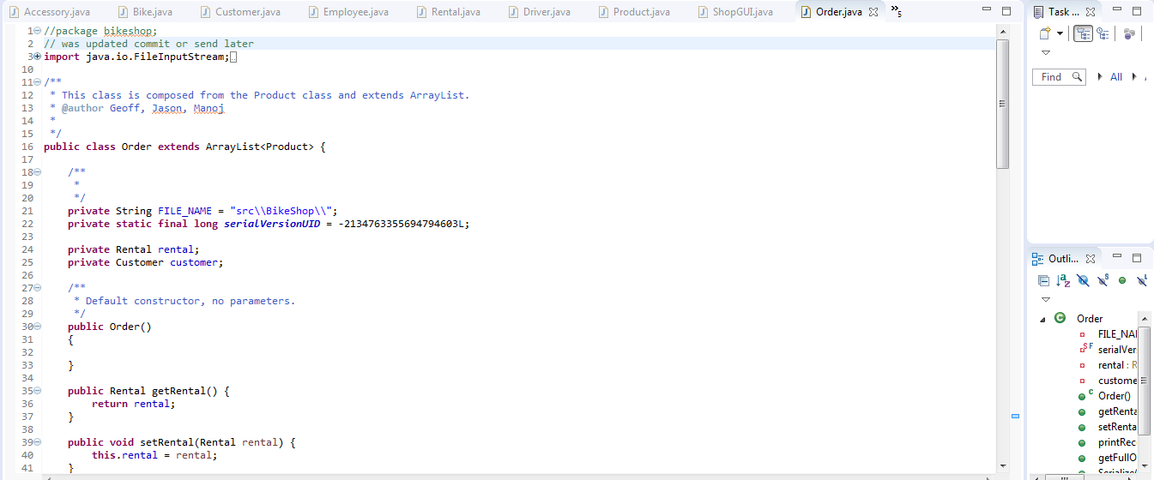
ECLIPSE

Slide 4
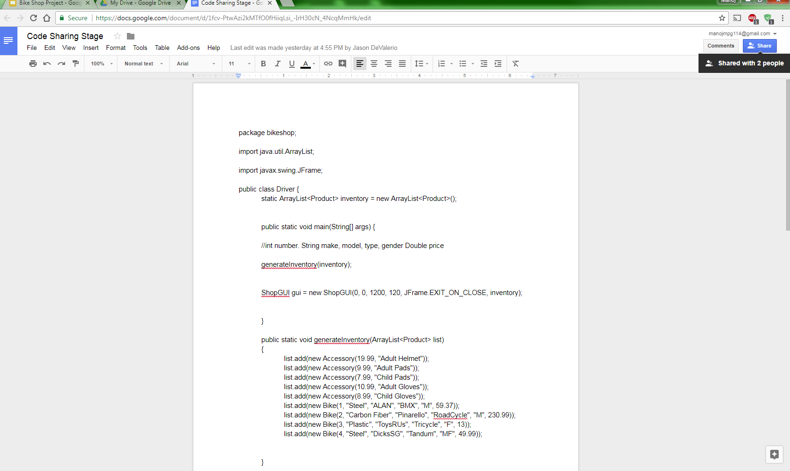
Google Doc

Slide 5
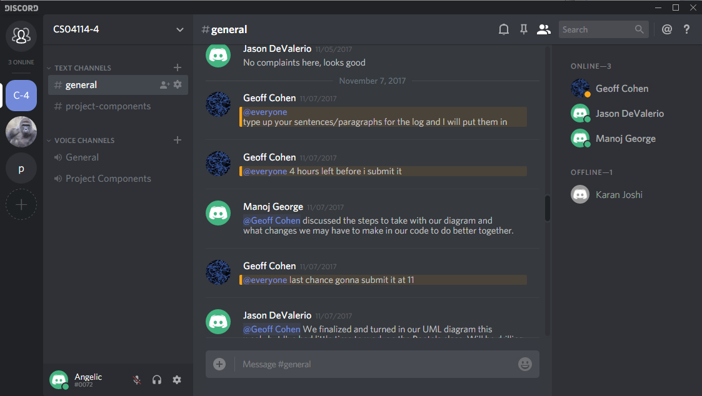
Discord

Slide 6
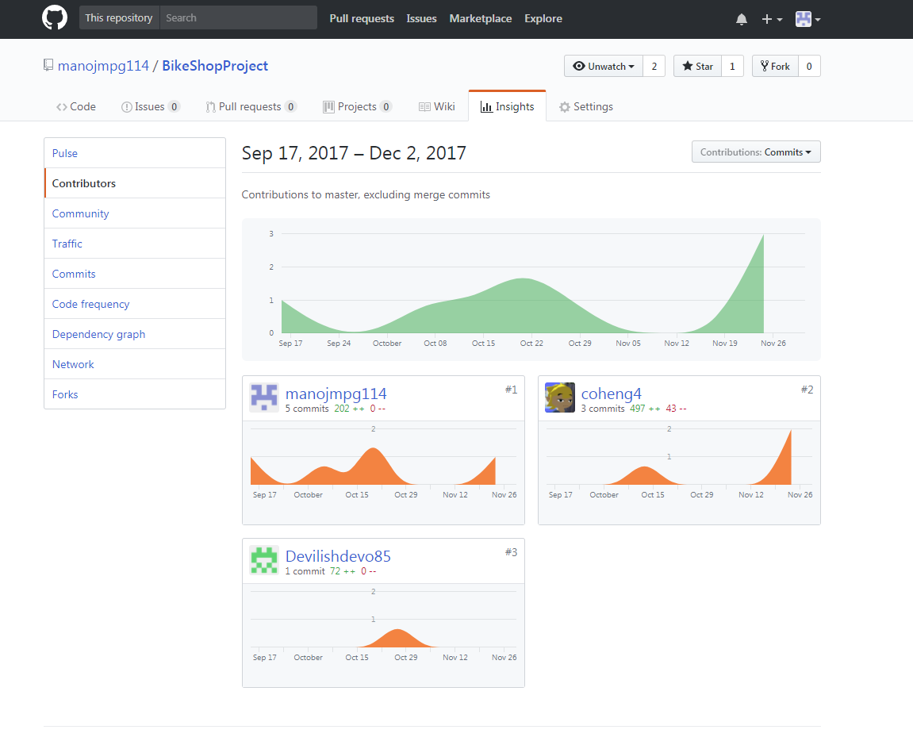
GITHUB

Slide 7
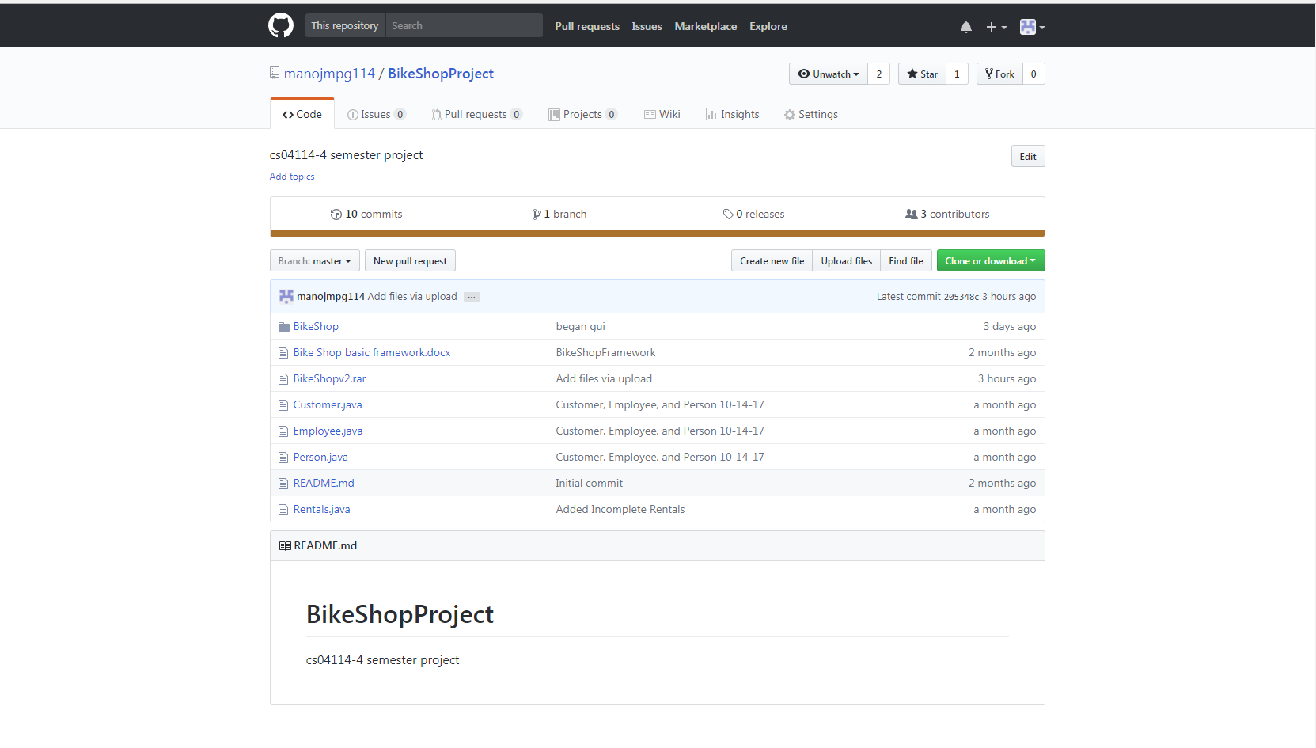

Slide 8
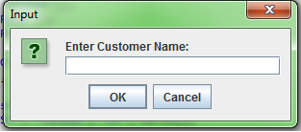
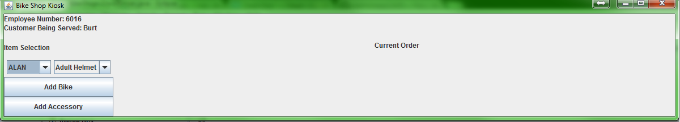
GUI Progression

Slide 9
Polymorphic Collections
Our products list is a collection of Accessories and Bikes in a List
private ArrayList<Product> productList;
public class Order extends ArrayList<Product> implements Serializable

Slide 10
Abstract Classes
We made our products class abstract because we thought it was the best way to deal with our other classes that consisted of accessory and bike types. We Had the different objects be subclasses of the abstract Product class.

Slide 11
Interfaces
We used the serialization interface in our project. Although we didn’t have to use it we wanted to cover more of the topics we discussed in class for better practice and familiarity. If so desired we could store different orders and call them again so we had methods to both serialize and deserialize these objects.

Slide 12
Swing GUI
Getting the order to print out correctly
Layouts have been troublesome
Errors abundant but are being worked on
We fixed most of our errors
There are a lot of dialog boxes to start which although is intended might become a slight annoyance to our client one day
Spacing and making the layout exactly as we wanted was tough but tried our best

Slide 13
Customized Error Handling
Where did you use it?
In serialize and deserialize methods
Did you like using it? Or did you feel it was overkill?
Didn’t like using but not overkill

Slide 14
File Input/Output
File input and output for serialization
FileInputStream
ObjectInputStream
FileOutputStream
ObjectOutputStream

Slide 15
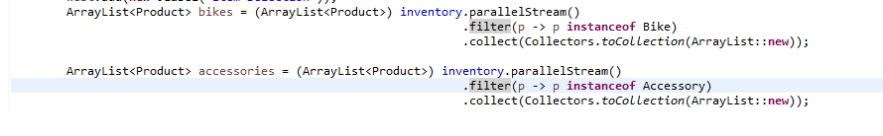
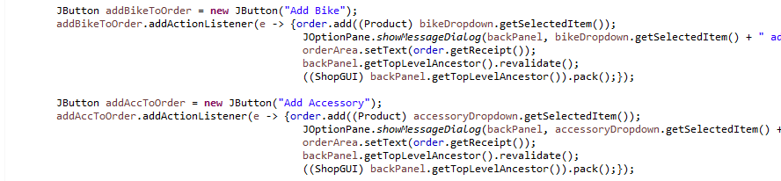
Lambda Expressions

Slide 16
Design Patterns
Which design patterns did you use (if any) for this project?
Which design patterns would make sense for this project?
MVC(Model, View, Controller)
Our gui takes information passes from the different classes without impacting the other classes
Open/Closed Principle
Singleton
Inner class although near the end we realized it was never used but has potential
Decorator
Used often with our products and within our serialization
Observer
Our order output as the customer makes their selections

Slide 17
Team Contributions
Geoff Cohen
Team Log
GUI
All Other Classes
Keeper of the team logs
Jason DeValerio
Team Log
All Classes
Manoj George
Team Log
All Classes
Middle Man for communication
PowerPoint
Karan Joshi
Team Log

